Slide 1


Airport Management System

Slide 2

Overview
Comprehensive Software Solution:
Manages and coordinates airport functions and operations.
Flight Operations:
Includes modules for scheduling flights and assigning gates.
Operational Efficiency:
Aims to streamline airport operations for improved efficiency.
Essential for the smooth functioning and safety of airport activities.

Slide 3

Problem Statement
To implement an airport management system, which simulates various functions of an airport. This system s designed used to manage and coordinate the various functions and operations of an airport. Our system is designed to manage flight schedules, gate assignments, baggage handling, and passenger check-in and boarding.

Slide 4
Business Rules
The System is used to manage only a single airport.
Each passenger can purchase tickets individually or as a group and each booking is uniquely identified by a order_id.
Only the passenger traveling can book the ticket.
Tickets are assigned to passengers and uniquely identified by a combination of order_id and ticket_id.
Each ticket is associated with 1 or more baggage and each piece of baggage is uniquely identifiable by a baggage_id.
All flights to and from the airport are tracked with each flight having a unique flight ID, source, and destination.
Flights are operated by airlines with specific airline_id and route numbers to track their corridors.
The airport is managed by airline staff who can be tracked by their staff_id. Their basic details like first name, last name, and email address must be given.
All the cities connected to the airport are managed by the airport_code to track which airport the flight is arriving from.

Slide 5
Entities
Airline
Terminal
Airport
Passenger
Orders
Airline Staff
Flight
Ticket
Baggage
Schedule
Airport Staff
Cleaning Schedule

Slide 6
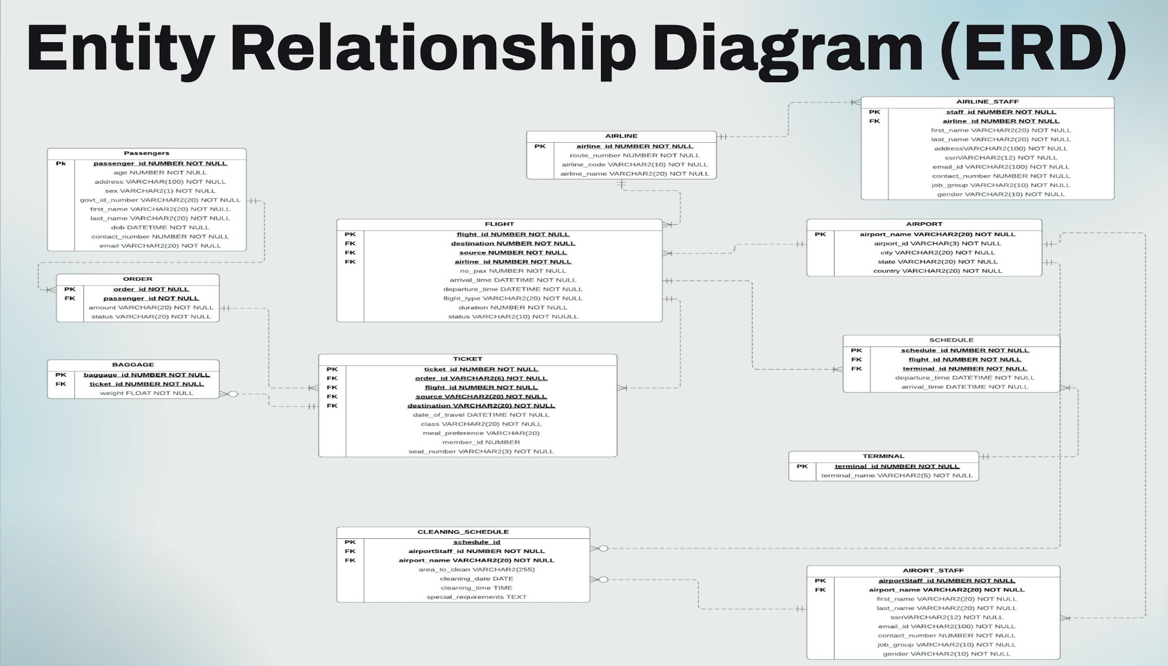

Slide 7
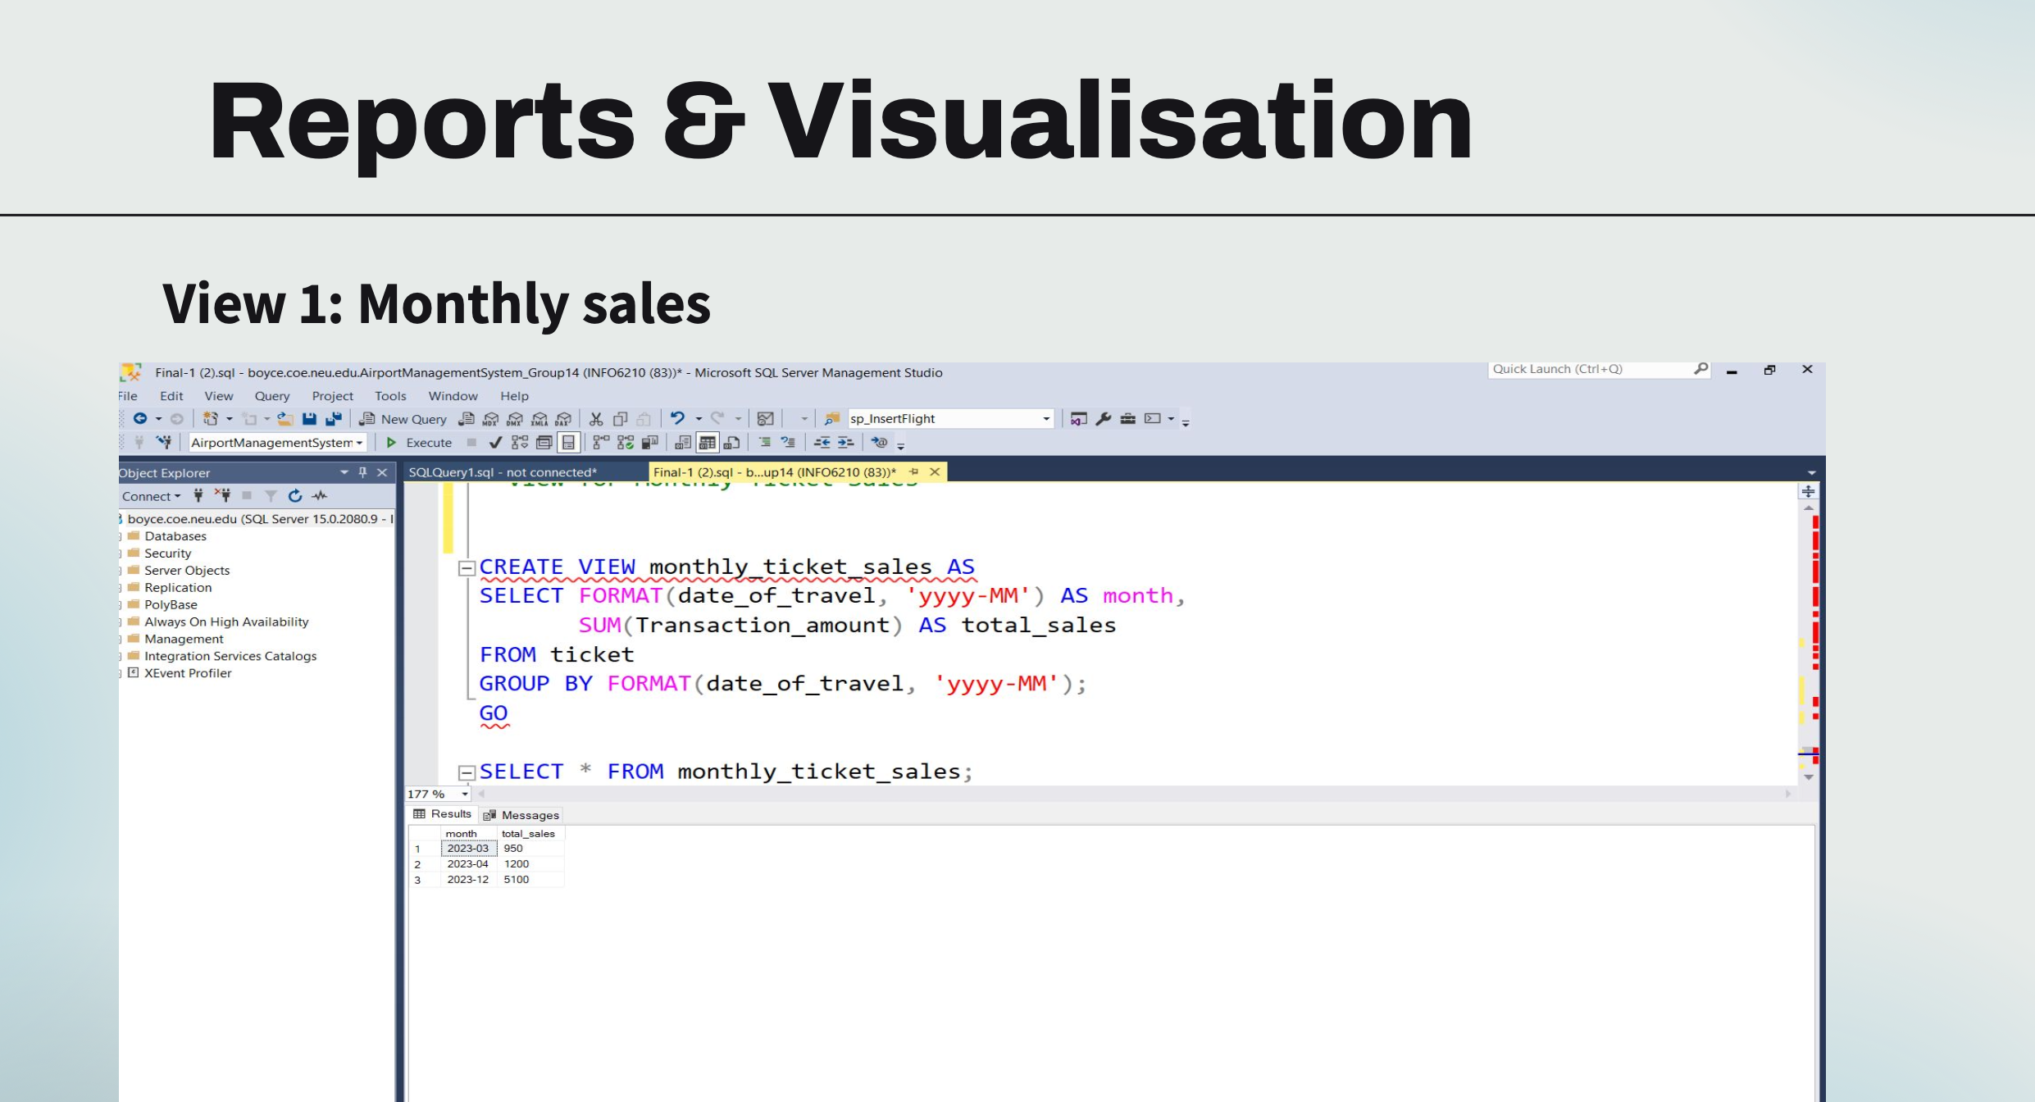

Slide 8
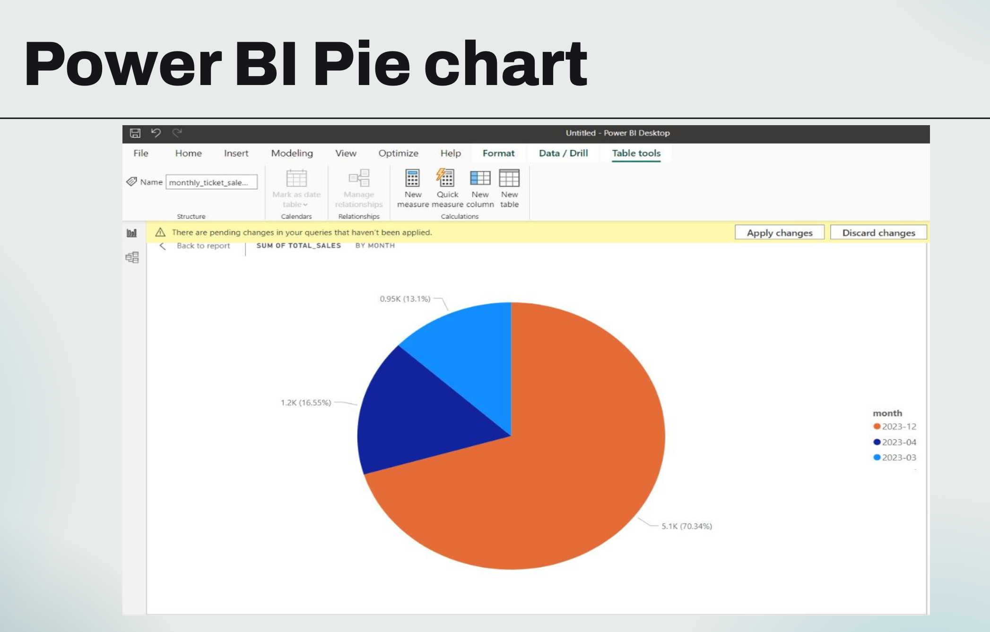

Slide 9
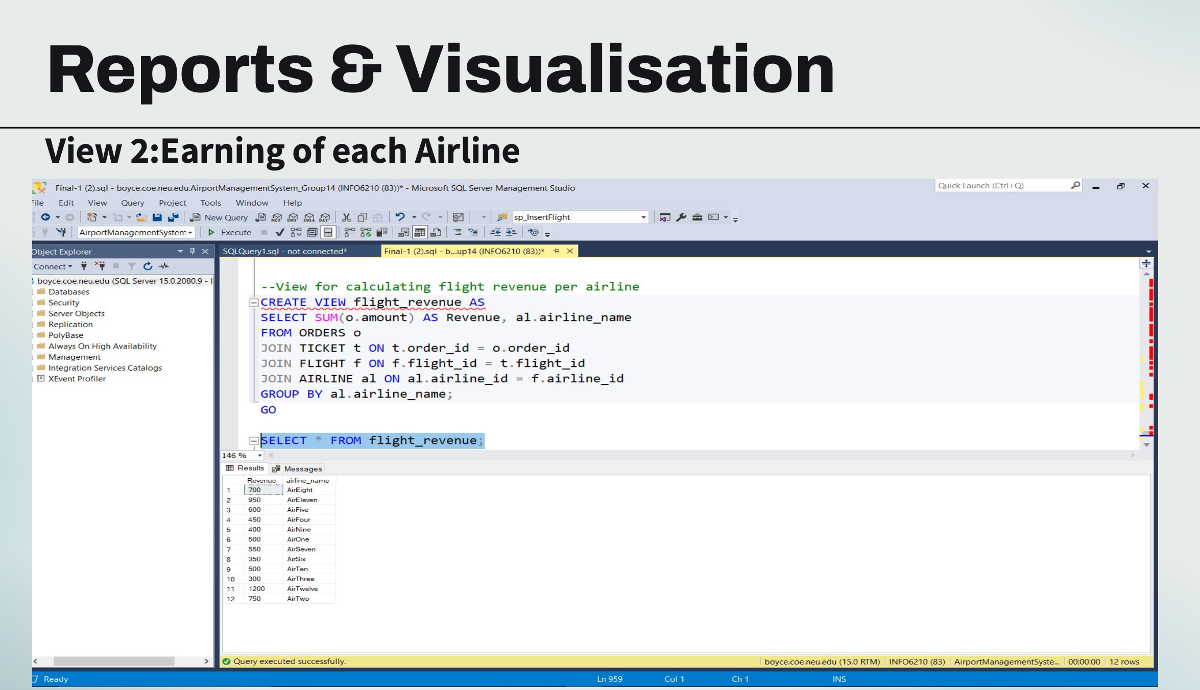

Slide 10
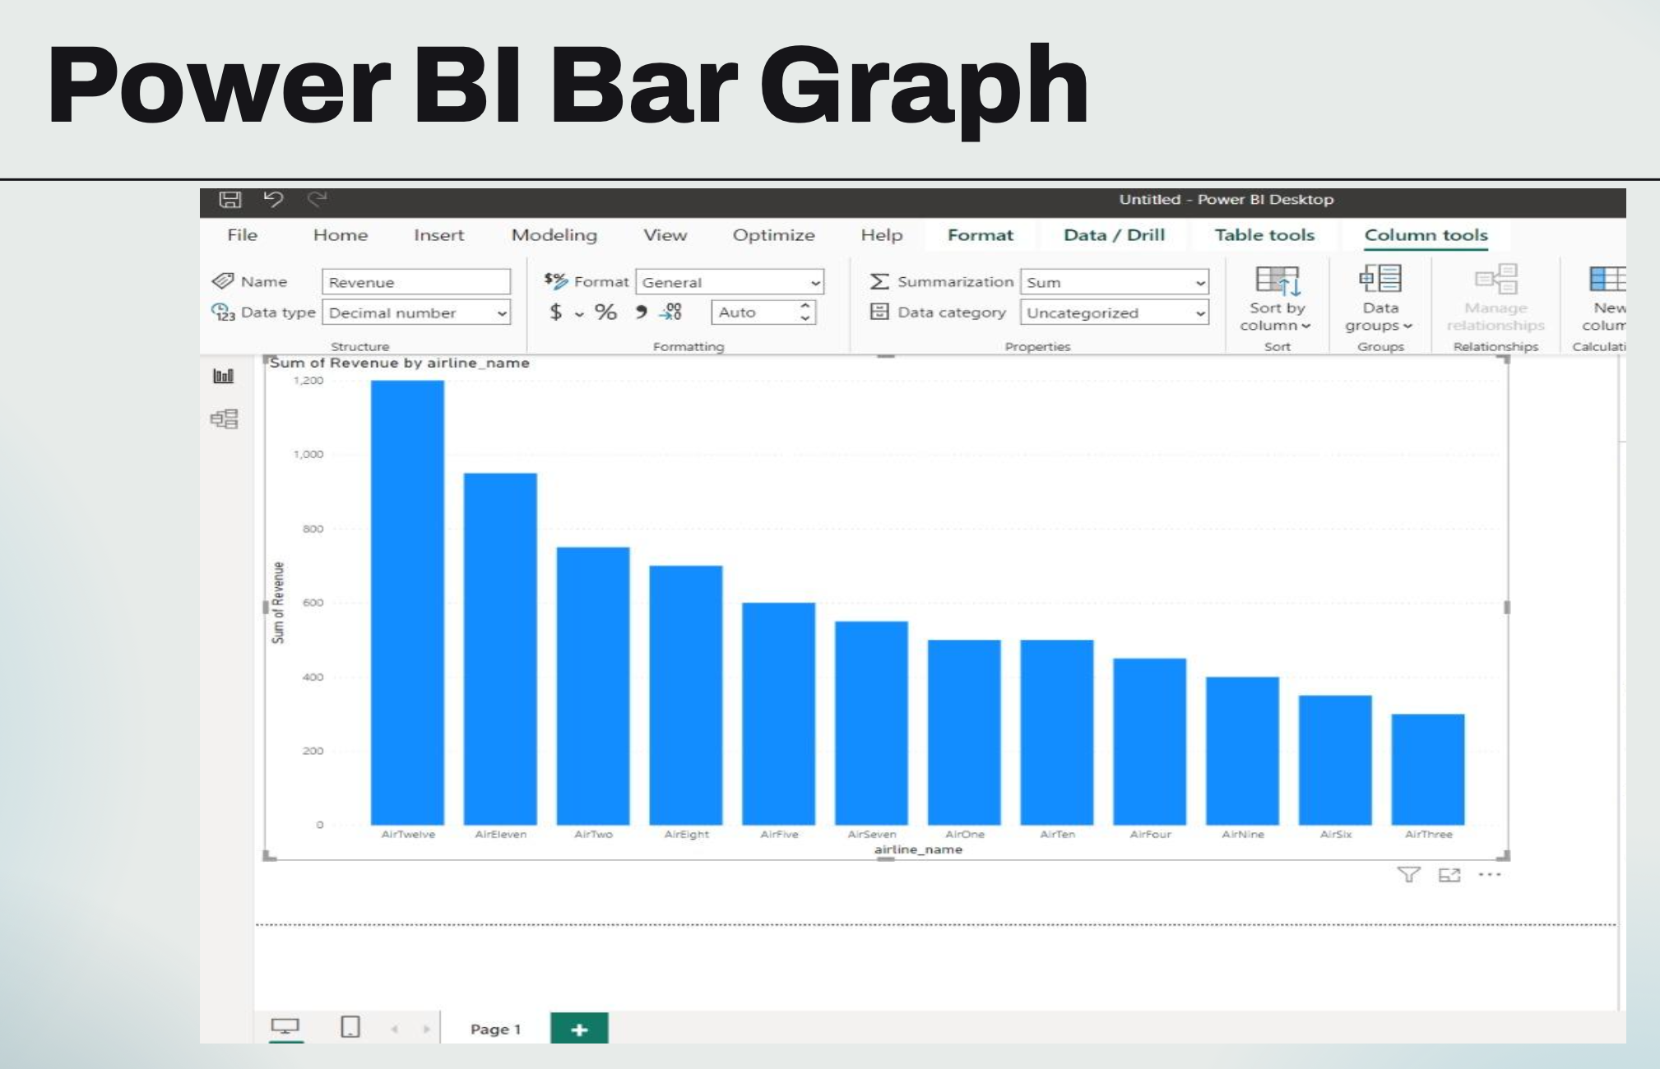

Slide 11
Thank you

